Slide 1
Java FX
Execution guidelines

Slide 2
Step 1: Create Java Project in Eclipse
Open Eclipse
Go to File → New → Java Project
Enter project name (e.g., JavaFXDemo)
Click Finish

Slide 3
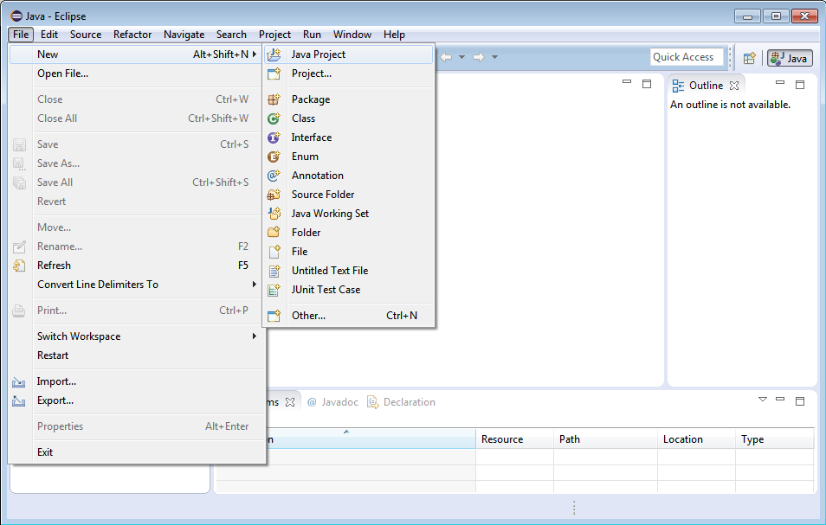

Slide 4
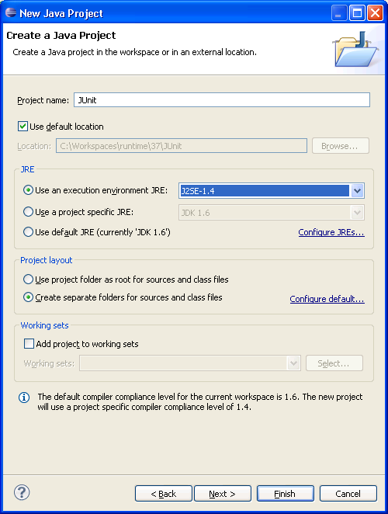

Slide 5
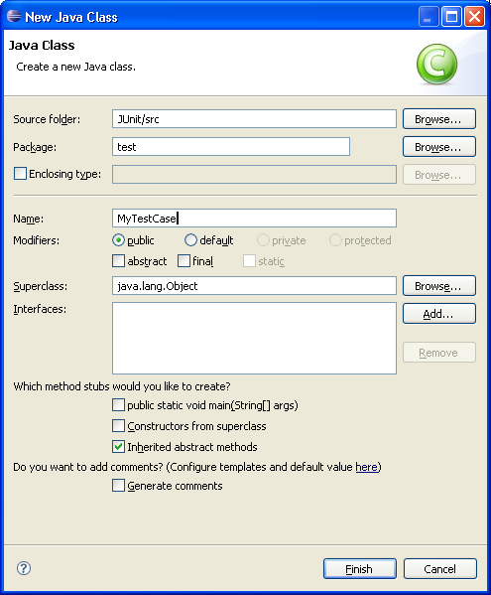

Slide 6
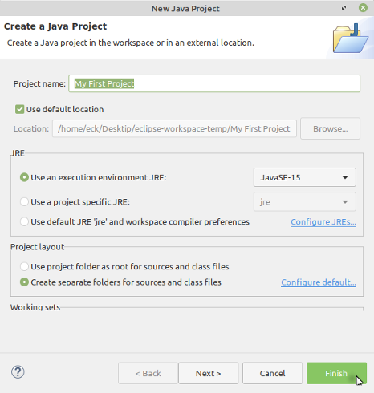

Slide 7
Step 2: Add JavaFX SDK Libraries
Right-click project → Build Path → Configure Build Path
Go to Libraries tab
Click Add External JARs
Select all .jar files from: javafx-sdk/lib
Click Apply & Close

Slide 8
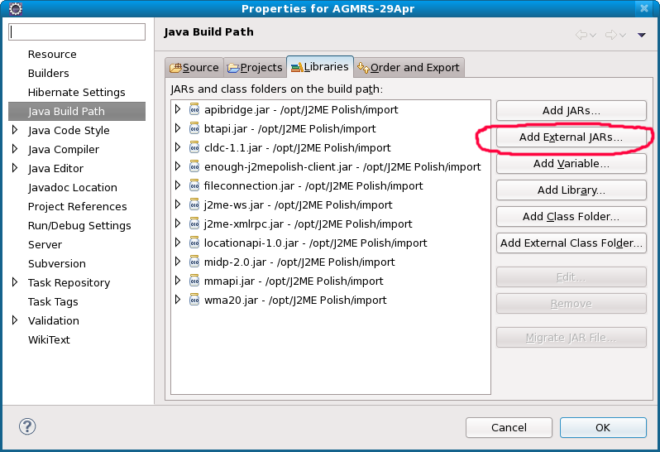

Slide 9
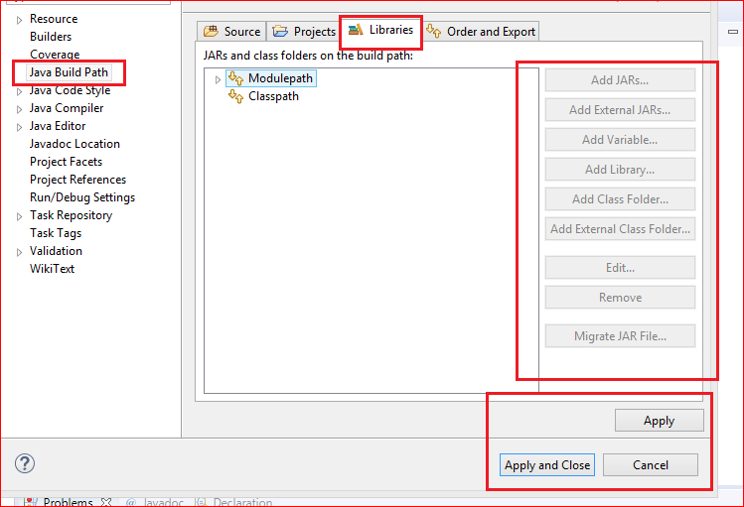

Slide 10
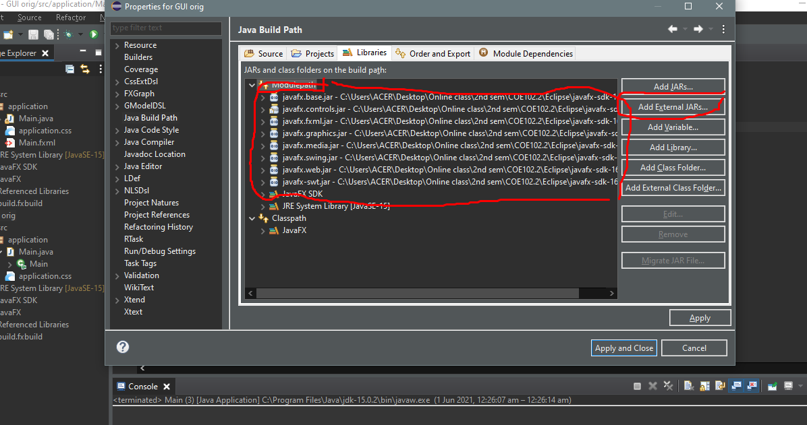

Slide 11
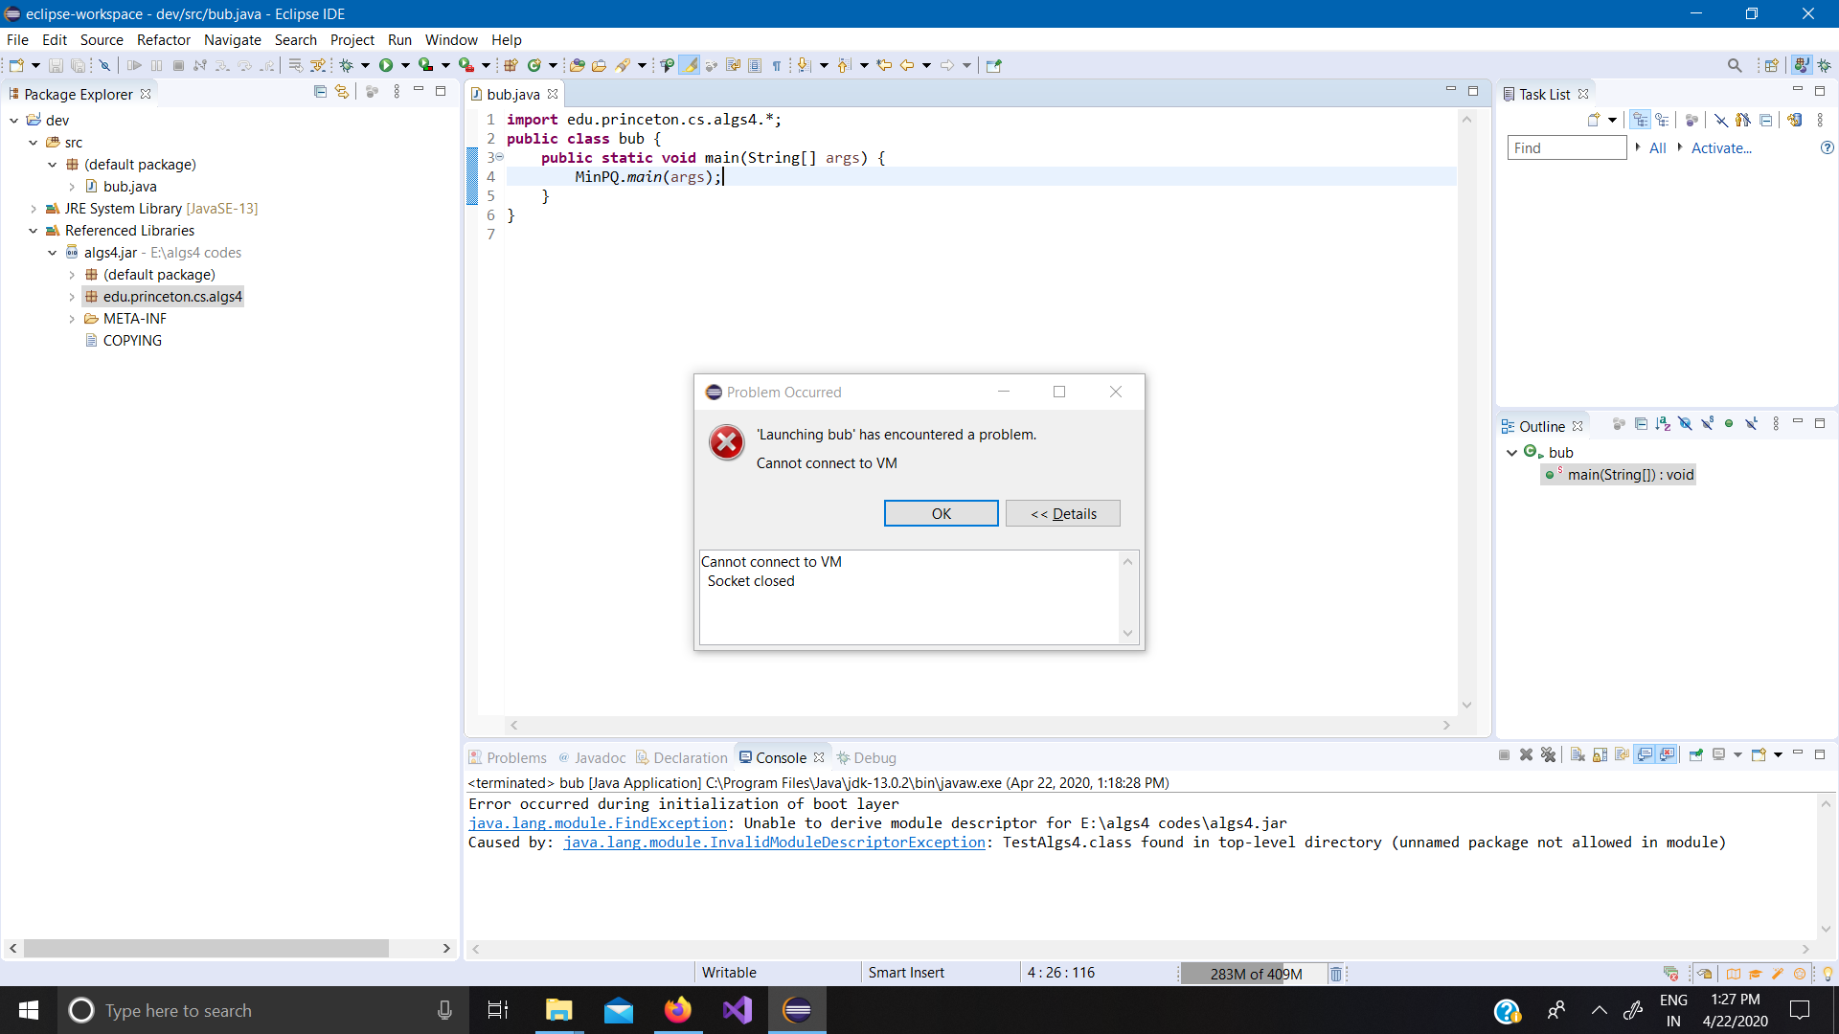

Slide 12
Step 3: Configure VM Arguments
Go to Run → Run Configurations
Select your project
Open Arguments tab
In VM arguments, paste:
--module-path "C:\javafx-sdk-21\lib" --add-modules javafx.controls,javafx.fxml
Replace path with your system location

Slide 13
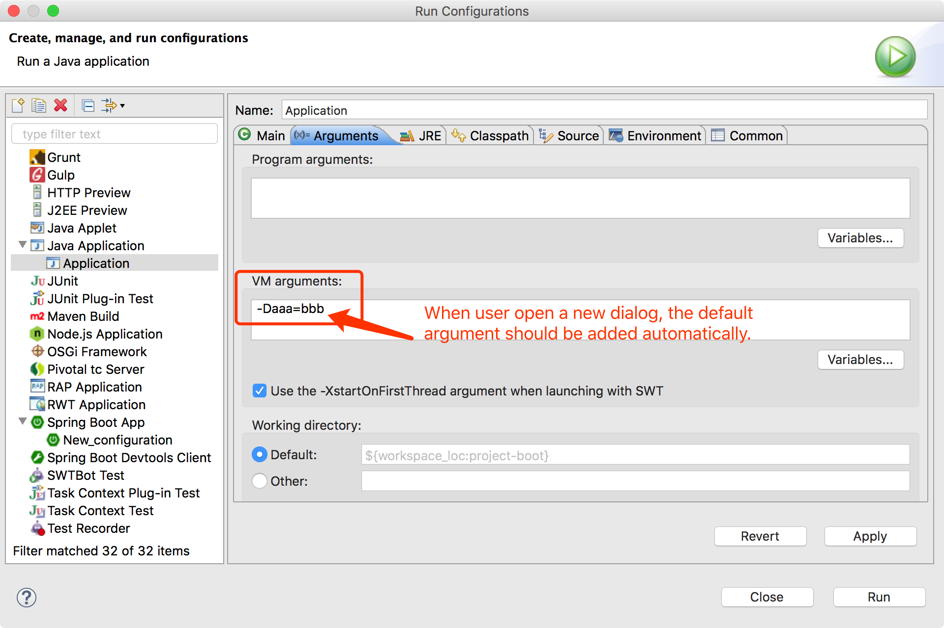

Slide 14
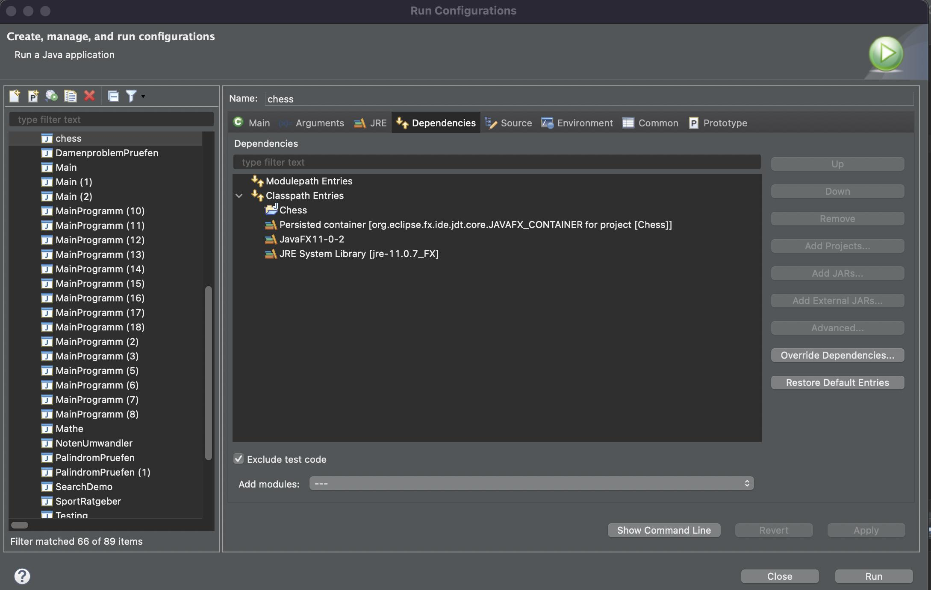

Slide 15
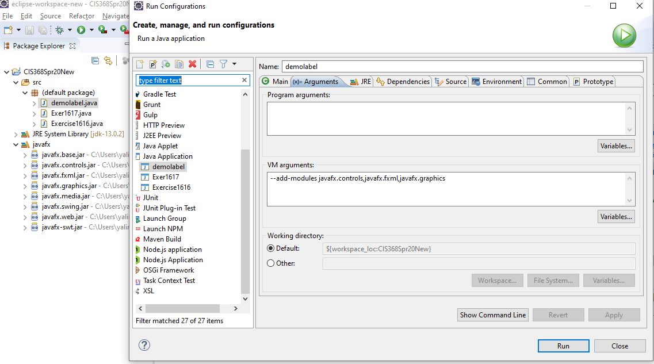

Slide 16
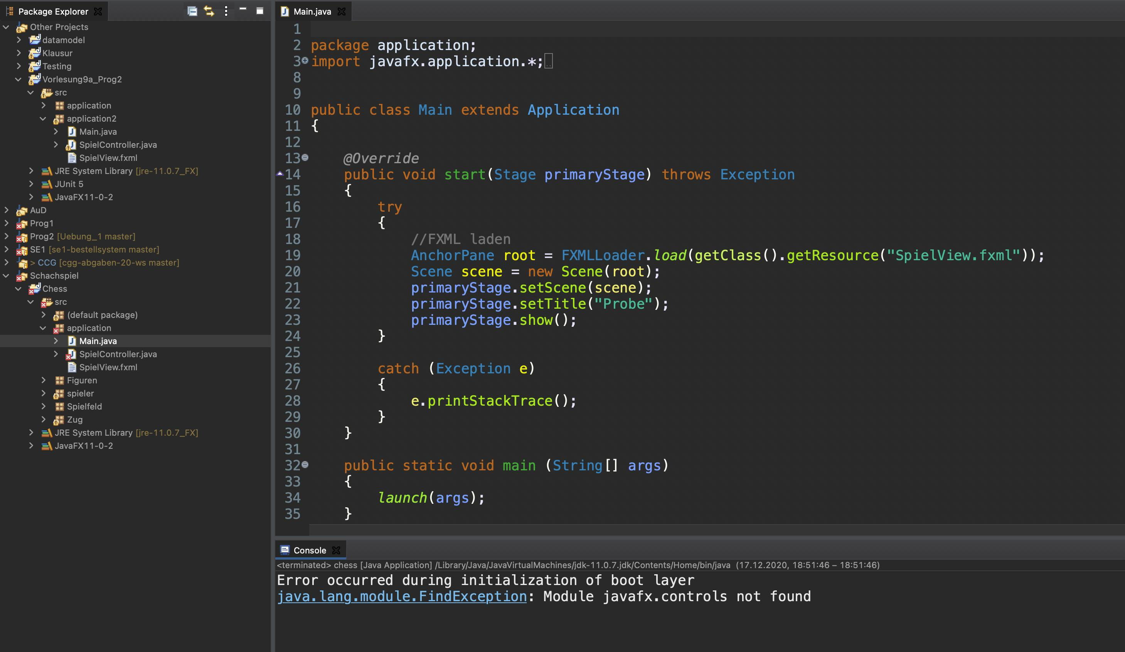

Slide 17
Step 4: Write JavaFX Code

Slide 18
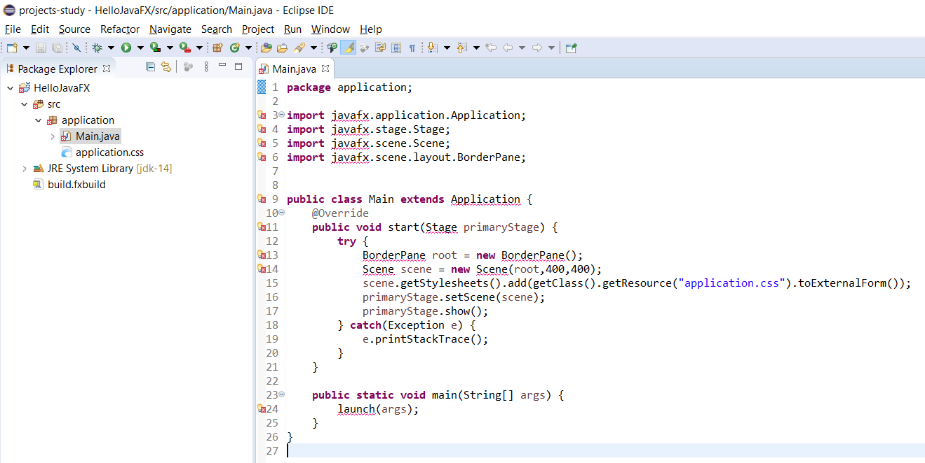

Slide 19
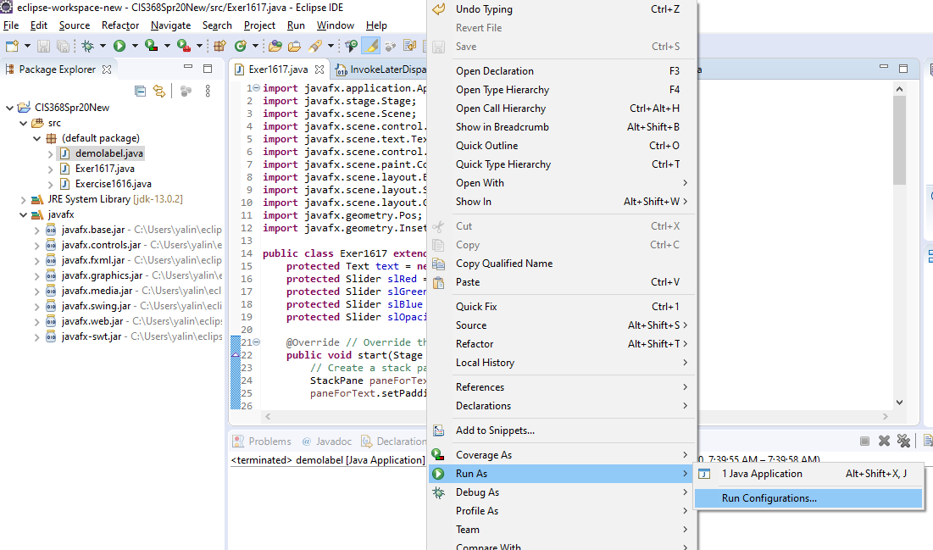

Slide 20
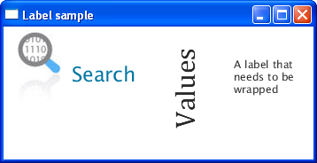

Slide 21
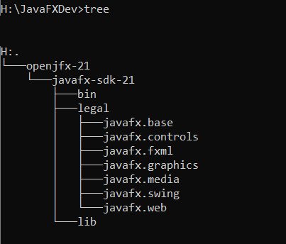

Slide 22
import javafx.application.Application;
import javafx.scene.Scene;
import javafx.scene.control.Label;
import javafx.stage.Stage;
public class HelloFX extends Application {
@Override
public void start(Stage stage) {
Label label = new Label("Hello JavaFX!");
Scene scene = new Scene(label, 400, 200);
stage.setTitle("My First JavaFX App");
stage.setScene(scene);
stage.show();
}
public static void main(String[] args) {
launch();
}
}

Slide 23
Step 5: Run the Program

Slide 24
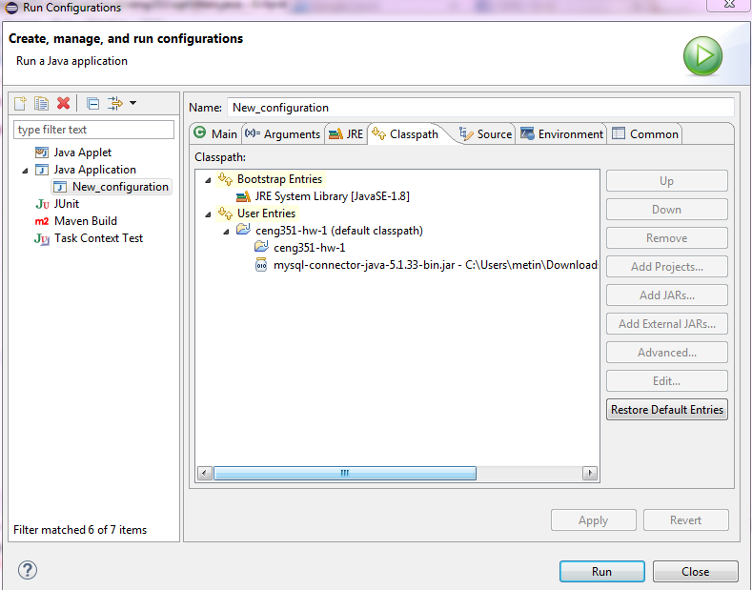

Slide 25
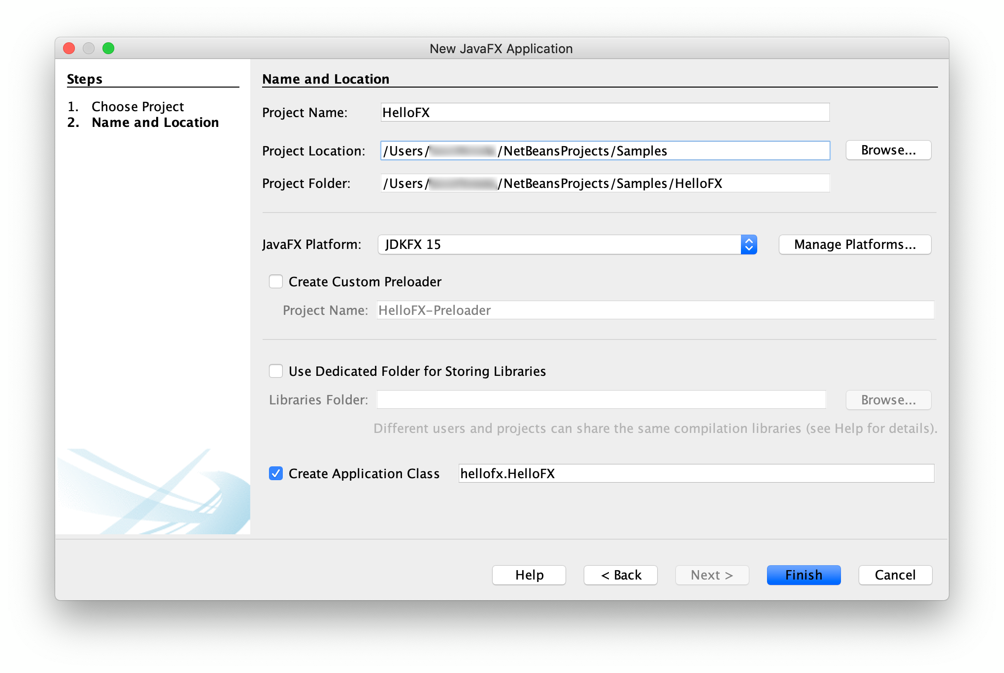

Slide 26
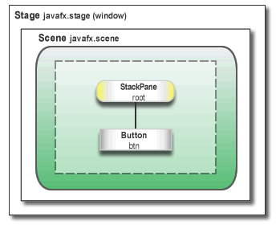

Slide 27
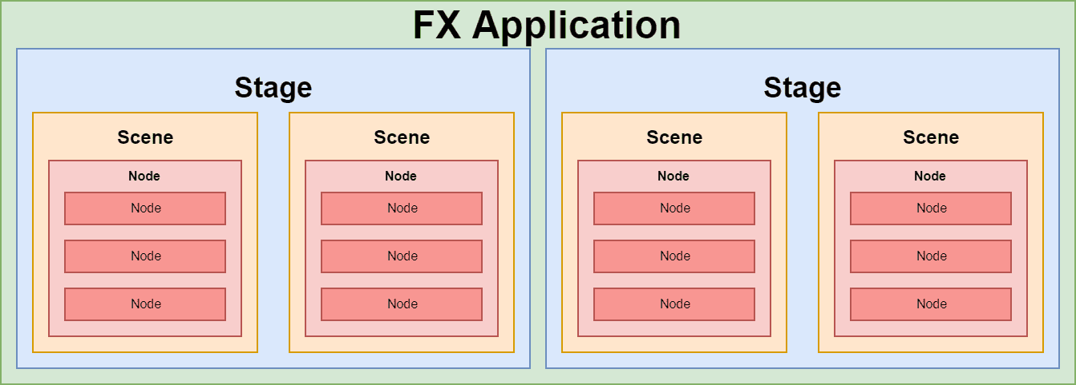

Slide 28
Common Mistake
If you see error “JavaFX runtime components are missing”
→because VM arguments are not set correctly

